Slide 1
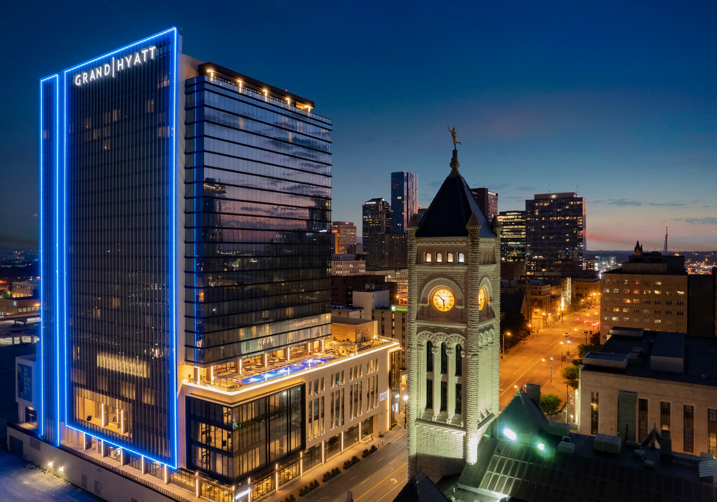
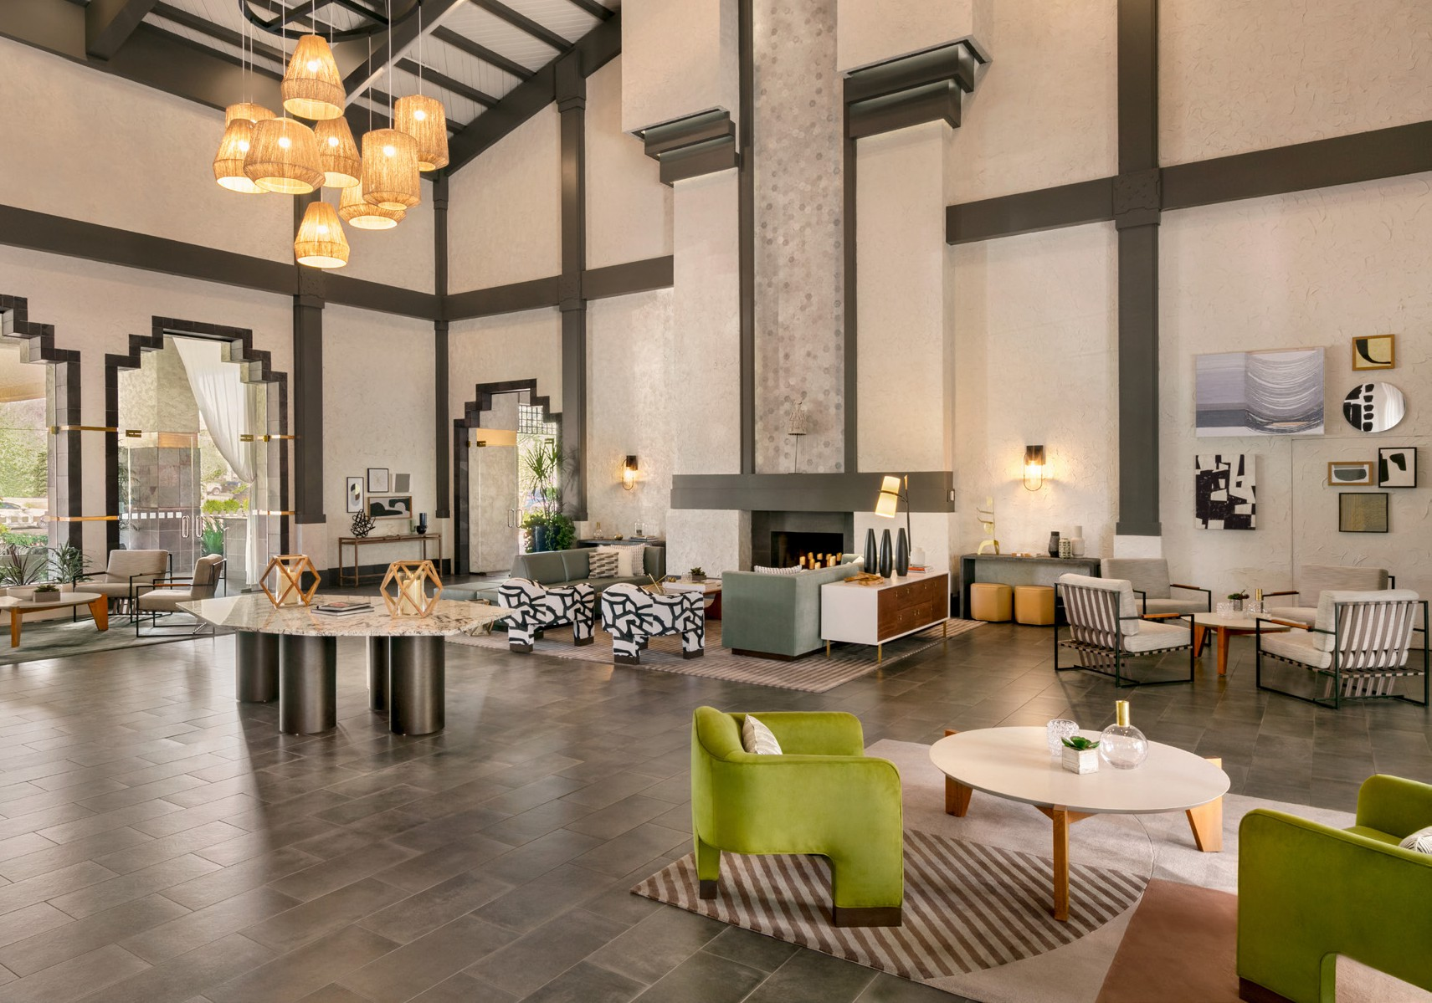
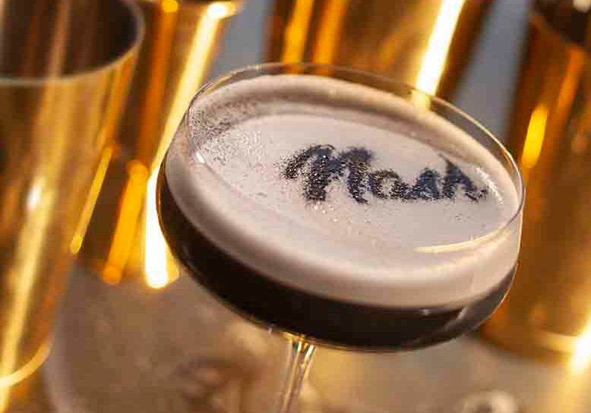
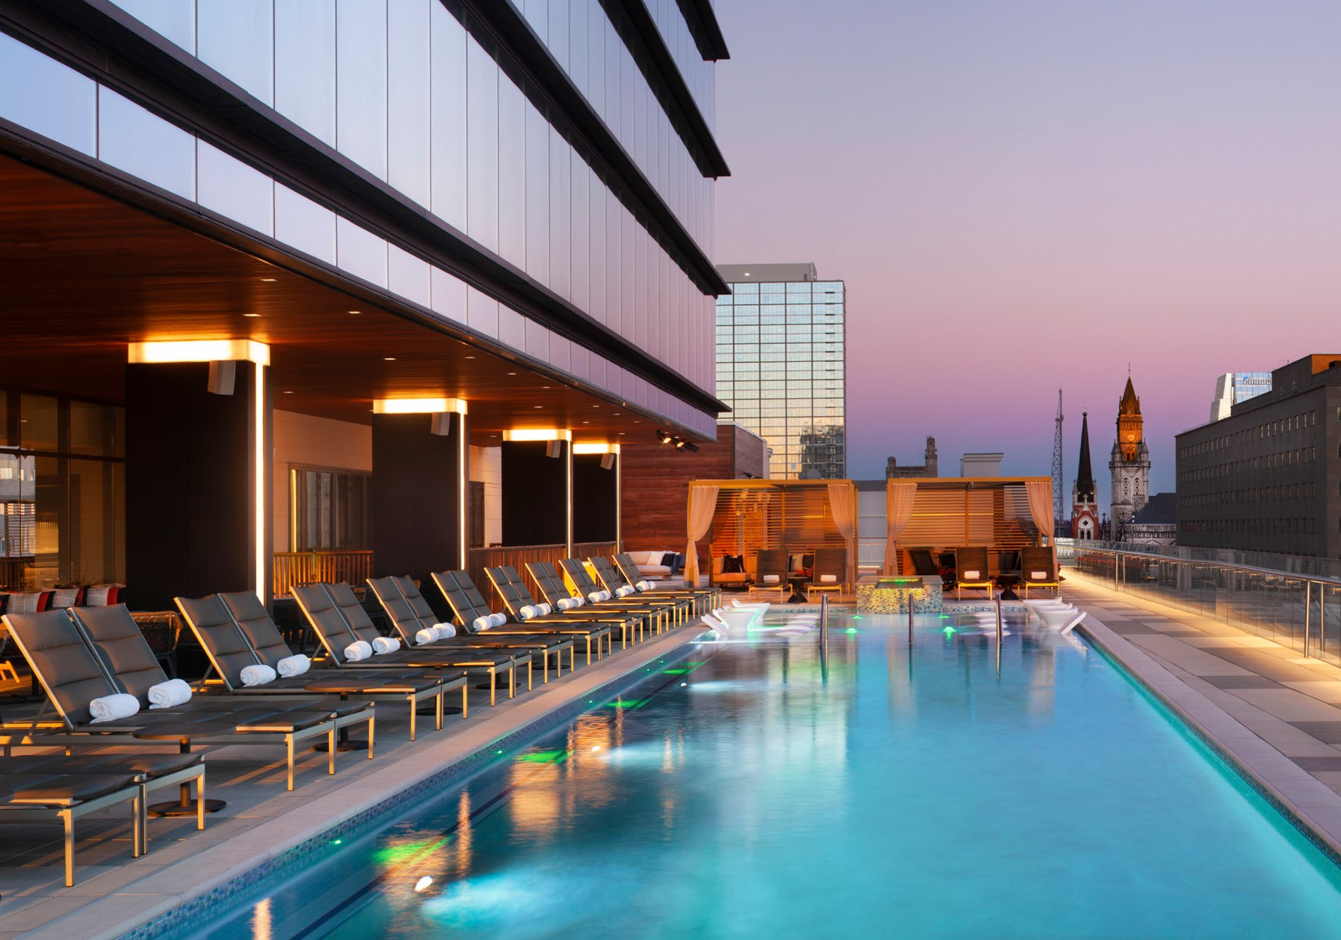
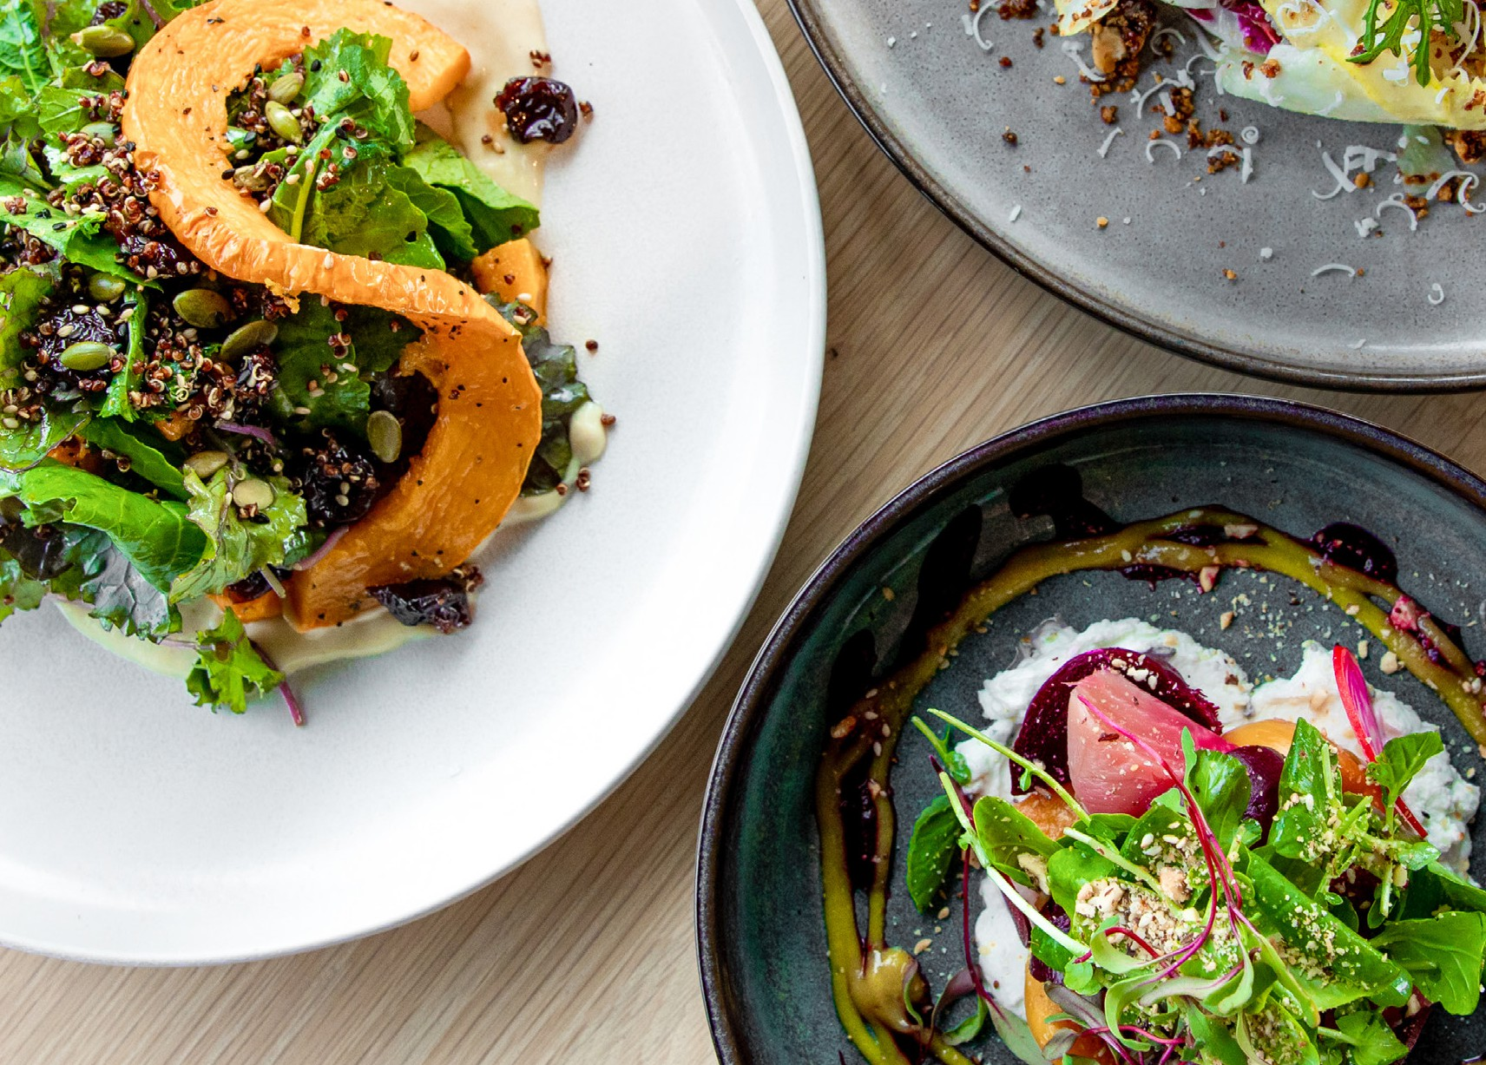
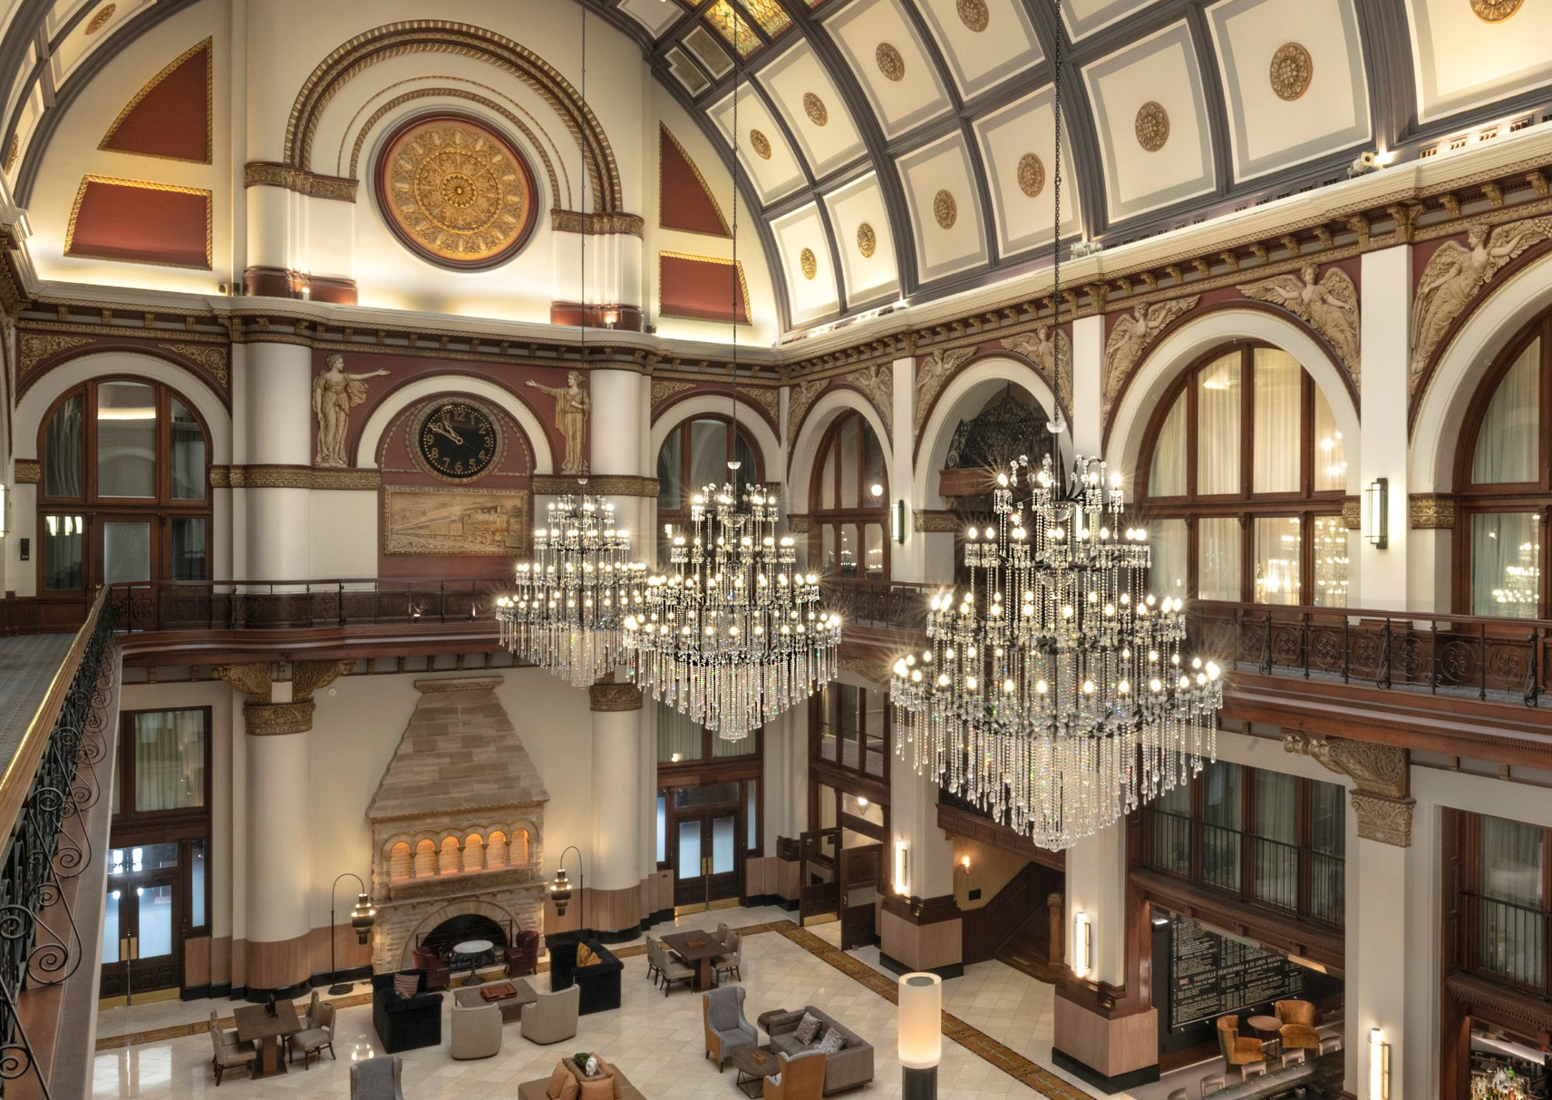
Accounting Chart of Accounts

Slide 2

USALI Compliance / Before-After
Department Structure
Four-digit Department (vs three)
Multiple Rooms Departments (vs one)
IT is separate from G&A
EWW/Utilities are separate from Maintenance
Account Structure
Miscellaneous Income Department has Revenue Only
Contract Labor is in Labor section, not Operating Expense
No overlap between Payroll and COGS accounts
Consistent Job Codes
Account numbers match from Department-to-Department
https://usali.hftp.org/

Slide 3
HM Alpha
Dimension COA → HM Alpha COA
Example: Room Attendant
Dimension
D200-54080-016
2 2005 60 2565 0

Slide 4
First Digit
Account Number:
1 = Balance Sheet
2 = Income Statement / P&L
9 = Statistic

Slide 5
Department Number
1000 = Balance Sheet | 3000 = Food Management | 5000 = Retail Management | 6000 = Miscellaneous Income
 | 3020 = Outlet #1 | 5020 = Retail #1
2000 = Rooms General | 3040 = Outlet #2 | 5040 = Retail #2 | 7000 = Administrative & General
2002 = Complimentary Services | 3060 = Outlet #3 | 5060 = Retail #3 | 7100 = Information Systems
2003 = Front Desk | 3080 = Outlet #4 | 5080 = Retail #4
2004 = Guest Services | 3400 = Banquet |  | 8000 = Sales & Marketing
2005 = Housekeeping | 3460 = Catering | 5300 = Valet Internal
2006 = Laundry | 3600 = Private Dining | 5320 = Valet External | 8500 = Property Operations & Maintenance
2007 = Reservations | 3700 = Room Service | 5340= Self-Park | 8700 = Energy, Water, Waste
2008 = Transportation | 3800 = Kitchen
 | 4000 = Beverage Management | 5400 = Golf Course Management | 9800 = NonOperating Income and Expense
 | 4020 = Bar #1 | 5420 = Golf Course Maintenance
 | 4040 = Bar #2 | 5440 = Golf Course
 | 4060 = Bar #3 | 5500 = Golf Pro Shop
 | 4080 = Bar #4
 | 4400 = Beverage Banquet | 5700 = Spa
 | 4460 = Beverage Catering
 | 9200 = Employee Cafeteria | 5800 = Conference Services
 |  | 5820 = Event Planning
Notes:
Rooms Department will continue to have a Consolidation. Revenue in 2000. Expenses separated by SubDepartment.

Slide 6

F&B Department Numbers
3000 = Food Management
3020 = Outlet #1
3040 = Outlet #2
3060 = Outlet #3
3080 = Outlet #4
3400 = Banquet
3460 = Catering
3600 = Private Dining
3700 = Room Service
3800 = Kitchen
4000 = Beverage Management
4020 = Bar #1
4040 = Bar #2
4060 = Bar #3
4080 = Bar #4
4400 = Beverage Banquet
4460 = Beverage Catering
9200 = Employee Cafeteria
 | Assign F&B Venue to a Department Number
Autograph Union Station | Ergo; Stationairy
DoubleTree Charlotte | Market Café; Bankers Lounge
DoubleTree Raleigh | Vintage Carolina; Lobby Bar
DoubleTree San Diego Del Mar | Mosaic
DoubleTree Sunrise | Peyton's; Proudly Brew Starbucks
Grand Hyatt Nashville | Grange; Lou/Na; Solstice; Aurum; Hummingbird Market / Food Trucks
Hilton Indianapolis | 120 West Bar & Grill; Proudly Brew Starbucks; Swing Suites
Hilton Scottsdale | Blue Fire Grill; Oasis/Tiki Bar/ Proudly Brew Starbucks
Hyatt Valencia | Greater Pacific; Proudly Brew Starbucks; Airstream
Hyatt Westlake | Harvest
Intercontinental New Orleans | Peets Restaurant
JW Marriott Houston | Main Kitchen / Rooftop Pool Bar & Grill (806 Main)
Marriott Del Mar | Arterra; Proudly Brew Starbucks
Marriott Warner Center | Amuse; Amuse Bar; Urban Oasis Poolside Lounge; Starbucks
Westin La Paloma Resort & Spa | AZuL Restaurant & Lounge; Sabino’s Pool Bar & Grill; Espresso

Slide 7
Sixth Digit: Account Type
                Account Type:
                1 = Balance Sheet Asset
                2 = Balance Sheet Liability
                4 = Revenue
                5 = Cost of Sales
                6 = Payroll/Labor
                7 = Expense
                8 = NonOperating
                9 = Statistic

Slide 8
Payroll Accounts
Payroll Type:
60 = Internal Wages
66 = External Contract Labor
67 = Bonuses & Incentives
68 = Payroll Taxes
69 = Employee Benefits
699 = Allocated Payroll
Job Code:
▪ Unique
▪ 4-digit
▪ Matches all systems
(PayChex, M3 LM, etc.)
▪ Matches Contract Labor
Last Digit:
1 = Allocated
0 = Regular Time
4 = Over Time

Slide 9
Payroll Examples
Examples:
Room Attendant Regular Wages
Room Attendant Overtime Wages
Contract Labor filling in for Room Attendant
Contract Labor filling in for Comp Services
Sales Bonus
Maintenance State Unemployment Tax
Maintenance Vacation Pay
GL Codes:
2 2005 60 2560 0 “60” Internal Wages
2 2005 60 2560 4 “4” Over Time
2 2005 66 2560 0 “66” Contract Labor
2 2002 66 2250 0
2 8000 67 0020 0 “67” Bonus
2 8500 68 0060 0 “68” Tax
2 8500 69 0080 0 “69” Benefits

Slide 10
Rooms Revenue
 | Transient Retail |  | Group Tour
2 2000 40010 00 | Retail | 2 2000 40800 00 | Group Tour
2 2000 40020 00 | OTA Retail |  | Group SMERF
 | Transient Discounted | 2 2000 40850 00 | Group SMERF
2 2000 40130 00 | OTA Discounted |  | Contract Airline
 | Transient Negotiated | 2 2000 40900 00 | Contract Airline
2 2000 40240 00 | Corporate Negotiated |  | Contract Other
2 2000 40250 00 | Local Negotiated | 2 2000 40950 00 | Contract Other
2 2000 40260 00 | Government
 | Transient Qualified |  | Other Rooms Revenue
2 2000 40370 00 | Qualified Discount | 2 2000 41000 00 | Cleaning-Smoking Fee
2 2000 40380 00 | Other Discount | 2 2000 41020 00 | Club/Lounge/Concierge Fee
2 2000 40390 00 | Rewards Redemption | 2 2000 41040 00 | Day Use Revenue
 | Transient Wholesale | 2 2000 41060 00 | Early Check-in Fee
2 2000 40400 00 | FIT/Wholesale | 2 2000 41070 00 | Early Departure Fee
 |  | 2 2000 41080 00 | Late Check-out Fee
 | Group Corporate | 2 2000 41100 00 | No Show Penalty
2 2000 40500 00 | Group Corporate | 2 2000 41120 00 | Other Rooms Revenue
 | Group Association | 2 2000 41140 00 | Pet Fees
2 2000 40600 00 | Group Association | 2 2000 41160 00 | Rental Bed/Crib
 | Group Government | 2 2000 41180 00 | Service Charge Revenue
2 2000 40700 00 | Group Government | 2 2000 42000 00 | Allowances

Slide 11
Balance Sheet Accounts
Type & Department:
11000 = Balance Sheet
Account Type:
1 = Asset
2 = Liability
3 = Equity
Period:
1 = Current Term
5 = Long Term
Category:
0-9 Groups
Examples:
Current Assets
Hotel Safe
Fixed Assets
Vehicles
Current Liabilities
Accounts Payable
LongTerm Liabilities
Mortgage
11000 1 1 10020
11000 1 5 30240
11000 2 1 20110
11000 2 5 11100
Notes:
Banking Activity will be available each morning at M3 Pro Services Sharefile site.

