Slide 1





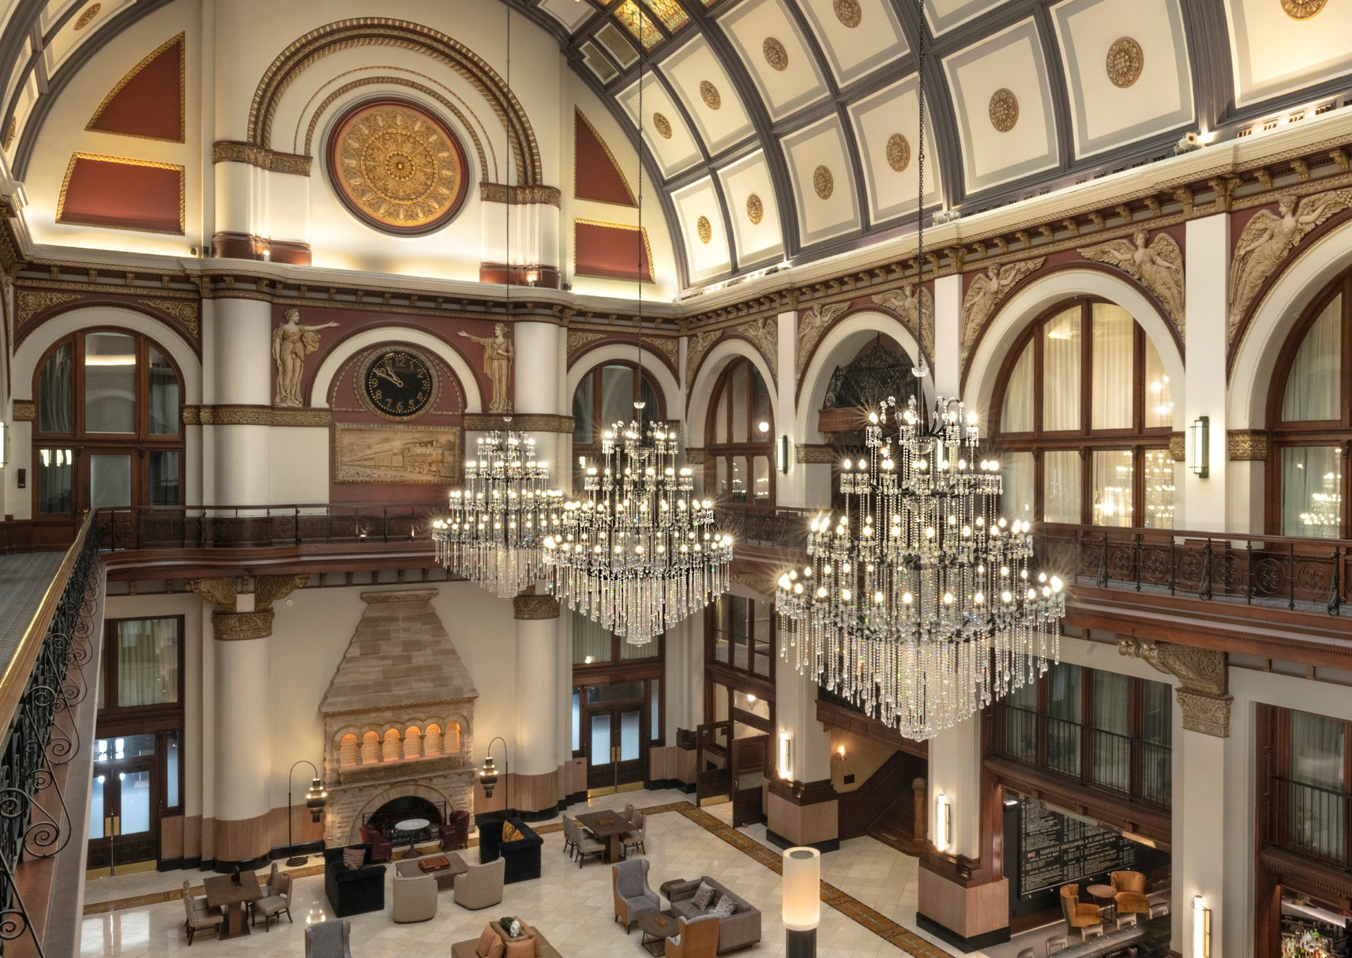
Transition Timeline:
M3 Pro Services

Slide 2
Dimension Home Office → M3 Pro Services
What: Recurring Accounting Functions
Who: Dimension Home Office → M3 Pro Services
When: November Go-Live, First Close in December
Where: Sage → M3 Accounting Core
How: Training and Support
Discuss Specific Job Duties
Notes:
Tory Waterman

Slide 3

Putting This Change in Context
= Major System Change
→
Function
Reporting/Forecasting
Accounting
Purchasing
Payment
Purchasing Cards
Purchasing
Travel
Beverage Payment
Payments/Contracts
Certifications/Permits
Maintenance
Contract Labor
Time & Attendance
2025 Implementations
Labor Management
Analytics
Inventory
Dimension Hospitality
DH ProfitSword
Sage Accounting
Avendra/iBuyEfficient
DH Corporate AP Team
Ramp Purchasing Cards
DH Amazon Business Accounts
DH CTM Travel Management
DH Fintech
DH Sertifi
DH Certrax & Pertrax
DH Quore
DH Work Records
Unifocus
Unifocus
DH ProfitSword
Avendra
HM Alpha
HMA ProfitSword
M3 Accounting Core / Adra
HSM/Birchstreet
BirchPay
Certify Purchasing Cards
HMA Amazon Business Accounts
HMA CTM Travel Management
HMA Fintech
HMA Sertifi
HMA Certrax & Pertrax
HMA Quore
HMA Work Records
M3 Labor Management
M3 Labor Management
M3 Insight & HMA Profit Sword
Birchstreet Inventory
→
Notes:
Tory Waterman – 5 New Systems. 8 Continuing Systems.

Slide 4
What
Who
Dimension Home Office → M3 Pro Services
M3 Pro Services will be your new “Home Office Accountant”
Balance Sheet Reconciliations
Monthly. Balance and track documentation. (DOFs will now have visibility)
Bank Reconciliations
Daily. Know what is received and reported as cash. (DOFs will now have visibility)
Working Papers
Reconciled with balance sheet accounts and embedded excel backups.
Analytical Reviews
Monthly. Review of financial statements.
Sales/Use/Occupancy Tax Filing & Remittance
Calculate tax filings and remit payments.
Notes:
Tory Waterman

Slide 5
When
Dimension Home Office → M3 Pro Services
September (close with Dimension by Oct 15)
October (close with Dimension by Nov 15)
November (close with M3 Pro Services by Dec 12)
September
▪ System Building
▪ Chart of Accounts
October
▪ System Integration
(ProfitSword, BirchStreet, BirchPay, etc.)
▪ Training - help.m3as.com
November
▪ Training
▪ Daily Reporting
▪ Go-Live November 1
December
▪ First Month-End Close
(November Close Dec 1-12)
Notes:
Tory Waterman

Slide 6
Sage Accounting → M3 Accounting
Accounting Process
Continue daily Night Audit Process in ProfitSword
Use Dimension ProfitSword until November 19 (estimate); then switch to HM Alpha ProfitSword
ProfitSword sends Daily Journal Entries to M3 beginning on November 2 with November 1 data
M3 Daily Reports can be run for November 1 beginning on November 2
M3 Pro Services
Monitors/reconciles bank activity throughout the month
Completes the Month-End Process with your input
Reconciles all Bank Statements & Balance Sheets
Month-End Process
November Month-End spans December 1-12
M3 Pro Services will be your new “Home Office Accountant”
Communicate with M3 Pro Services just as you would have with your Dimension Accountant
Continue to upload monthly items:
      Tax Exemptions, Inventory, Payroll, Franchise Invoices, Accruals, Reclasses, etc.
    Training and Help can be found at help.m3as.com
Daily:
Continue all Daily processes in ProfitSword
ProfitSword will export the Daily data into M3
Month-End Milestones:
Daily Information Uploaded by the 2nd
Informational Packs uploaded by the 4th
Accounts Payable closed by the 6th
Preliminary Close by the 10th
Final Close by the 12th
M3 Pro Services Team:
Brandon Lockridge – Supervisor
Sarina Conway – Senior Accountant
Jess Walker – Staff Accountant
Notes:
Matthew Schupbach

Slide 7
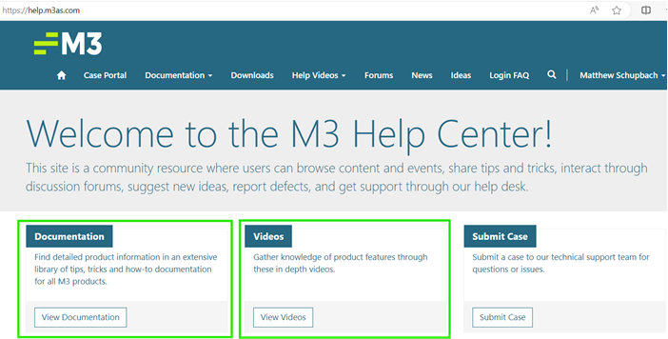
Support Matrix
M3 Pro Services
Executive Sponsor: Tory Waterman
Internal Guide: Matthew Schupbach
Supervisor: Brandon Lockridge (brandon.Lockridge@m3as.com)
Accountant: Sarina Conway (sarina.Conway@m3as.com)
Accountant: Jess Walker (jess.walker@m3as.com)
Training Materials
https://help.m3as.com
Dedicated Accountant
Autograph Union Station Jess Walker
DoubleTree Charlotte Jess Walker
DoubleTree Raleigh Brandon Lockridge
DoubleTree Del Mar Sarina Conway
DoubleTree Sunrise Jess Walker
Grand Hyatt Nashville Jess Walker
Hilton Indianapolis Sarina Conway
Hilton Scottsdale Sarina Conway
Hyatt Valencia Jess Walker
Hyatt Westlake Jess Walker
Intercontinental N.O. Sarina Conway
JW Marriott Houston Sarina Conway
Marriott Del Mar Sarina Conway
Marriott Warner Center Sarina Conway
Westin La Paloma Brandon Lockridge
Notes:
Tory Waterman / Matthew Schupbach / Devon Peters / Matt Owens

Slide 8
System Training Calendar
 | System | Training Topic
October 21
October 22 | M3 Timekeeping | Corporate/Management of Systems
October 23
October 24 | M3 Timekeeping | Biometrics
October 25
October 28 | HSM | Buying / Approving
October 29 | HSM | Receiving
 | M3 Accounting Core | Basic Training
October 30 | BirchStreet | AP Basics
 | BirchStreet | AP Advanced
 | M3 Accounting Core | Basic Training
October 31 | BirchStreet | AP Basics
 | M3 Accounting Core | AP Module
 | BirchStreet | Open Q&A
November 1 | M3 Timekeeping | Exporting
 | Open Office Hours | Open Q&A
M3 Training Tools and Sessions throughout October & November
Notes:
Tory Waterman

Slide 9
System Training Calendar
 | System | Training Topic
November 4 | M3 Timekeeping | Exporting
 | Open Office Hours | Open Q&A
 | M3 Accounting Core | AP Module
November 5 | M3 Timekeeping | Scheduling
 | Open Office Hours | Open Q&A
November 6 | Open Office Hours | Open Q&A
November 7 | Open Office Hours | Open Q&A
November 8 | Open Office Hours | Open Q&A
November 11 | M3 Timekeeping | Mobile App
 | Open Office Hours | M3 Accounting Core and ProfitSword
November 12
November 13
November 14 | M3 Timekeeping | Mobile App
November 15
Open Office Hours for Q&A throughout October & November
Notes:
Tory Waterman

Slide 10
System Training Calendar
 | System | Training Topic
November 18 | Open Office Hours | M3 Accounting Core and ProfitSword
November 19 | M3 Timekeeping | Exporting
November 20
November 21 | Open Office Hours | M3 Accounting Core and ProfitSword
November 22
November 25 | Open Office Hours | M3 Accounting Core and ProfitSword
November 26 | M3 Pro Services | Month-End Processes
November 27 | M3 Pro Services | Month-End Processes
November 28 | Open Office Hours | M3 Accounting Core and ProfitSword
November 29 | M3 Accounting Core | Basic Training
Notes:
Tory Waterman

Slide 11
System Training
 | System | Training Topic
December 2 | Open Office Hours | M3 Accounting Core and ProfitSword
December 3 | Open Office Hours | M3 Accounting Core and ProfitSword
December 4 | Open Office Hours | M3 Accounting Core and ProfitSword
December 5 | M3 Timekeeping | Labor Standards
December 6 | Open Office Hours | M3 Accounting Core and ProfitSword
December 9 | Open Office Hours | M3 Accounting Core and ProfitSword
December 10 | Open Office Hours | M3 Accounting Core and ProfitSword
December 11 | Open Office Hours | M3 Accounting Core and ProfitSword
December 12 | Open Office Hours | M3 Accounting Core and ProfitSword
December 13
We will walk along side you during Close
Notes:
Tory Waterman

Slide 12
Specifics
Which of my duties change?
Duties remain mostly the same
M3 Pro Services will be your new “Home Office Accountant”
How do I get System Access?
User access was sent on Oct 7 to Hotel Heads of Finance
Your login provides access to help.m3as.com
We will add other Hotel Users once the system is fully functional
Where do I upload/download my Files?
https://m3accountingservicesinc.sharefile.com
How do I see my daily Bank Activity?
https://m3accountingservicesinc.sharefile.com
Can I see the Balance Sheet reconciliations?
https://www.trintech.com/adra/ (location coming)
Notes:
Tory Waterman

Slide 13
Recurring Accounting Functions
During the Month Tasks | Dimension Process | M3 Pro Process | Dates
Daily Internal Bank Reporting | Hotel | Hotel | Daily
Cash Balancing Review | Hotel | Hotel | Daily
Cash Reconciliation in ProfitSword | Hotel | Hotel | Daily
Cash Over/Short Reporting | Hotel | Hotel | Daily
Reconciling Fintech Invoices to Bank | Hotel | Hotel | Daily
Credit Card Reconciliations | Hotel | Hotel | Weekly
Third Party Reconciliations (Resy,Stripe, Way) | Hotel | Hotel | Weekly
Bank Reconciliation Questions | Corporate Acct | M3 Pro Task | Weekly
Month End Preliminary Tasks | Dimension Process | M3 Pro Process | Dates
Final Day's Night Audit Reports Provided | Hotel | Hotel | 2nd
PMS Ledgers | Hotel | Hotel | 2nd
Accounts Receivable Review | Hotel | Hotel | 2nd
Tip/Gratuity Reconciliations for Month End | Hotel | Hotel | 2nd
Inventories provided to Corporate | Hotel | Hotel | 2nd
Payroll Entries Uploaded to ShareFile | Corporate Payroll | M3 Labor Management | 2nd
Tax Exemption Reports Provided | Hotel | Hotel | 2nd
Payroll JEs Posted | Corporate Acct | M3 Pro Task | 2nd
Payroll Accrual Posted | Corporate Acct | M3 Pro Task | 2nd
Bank Recs Completed Through EOM | Corporate Acct | M3 Pro Task | 3rd
Reconcile Credit Cards (Manager Card & Corp CC) | Corporate Acct | M3 Pro Task | 3rd
Confirm Ledgers Balance to Balance Sheet (City Ledger, Guest ledger, Advanced Deposits, etc.) | Corporate Acct | M3 Pro Task | 4th
Recurring JEs posted | Corporate Acct | M3 Pro Task | 4th
Prepaid JEs posted | Hotel ↔ Corporate Acct | Hotel ↔ M3 Pro Task | 4th
Close AP | Corporate AP | M3 Pro Task | 5th
Notes:
Tory Waterman - M3 Pro will be making the actual entries, but you will have access to their accounting system (Adra/Trintech) and can see all entries and documentation (like balance sheet documentation, bank statements, cc statements, etc.)

Slide 14
Recurring Accounting Functions
Month End Analytical Tasks | Dimension Process | M3 Pro Process | Dates
Bank Rec Variances Answered | Hotel ↔ Corp Acct | Hotel ↔ M3 Pro | 5th
Bank Recs Finalized | Corporate Acct | M3 Pro → Hotel | 6th
Franchise Invoice Posted to AP and Accrued | Hotel → Corporate Acct | Hotel → M3 Pro | 6th
Prelim Review Sent | Corporate Acct | M3 Pro → Hotel | 9th
Property Reclasses Provided and Posted | Hotel ↔ Corporate Acct | Hotel ↔ M3 Pro | 11th
Property Accruals Provided and Posted | Hotel ↔ Corporate Acct | Hotel ↔ M3 Pro | 11th
Financial Statements in Balance (BS and P&L) | Corporate Acct | M3 Pro Task | 12th
Property Final | Hotel ↔ Corporate Acct | M3 Pro Task | 12th
Prepare Financials | Hotel ↔ Corporate Acct | M3 Pro Task | 12th
Close GL for Period | Corporate Acct | M3 Pro Task | 12th
Month End Behind The Scenes Tasks | Dimension Process | M3 Pro Process | Dates
Tax Calculation Prepared/Sent | Corporate Acct | M3 Pro → HMA Corporate | 11th
Tax Calculation Approved | Corporate Acct | HMA Corporate → M3 Pro | 13th
Paper Taxes Submitted | Corporate Acct | M3 Pro Task | 13th
Tax Invoices posted to AP | Corporate Acct | M3 Pro Task | 20th
Tax Backup Saved to Sharefile | Corporate Acct | M3 Pro Task | 20th
Balance Sheet Reconciliation Complete and Uploaded in Adra | Corporate Acct | M3 Pro Task | 20th
All Treasury Functions | Corporate Acct | HMA Corporate | Daily
Notes:
Tory Waterman - Tax Exemptions will be uploaded from the hotel (like today) to the sharefile site. M3 Pro will perform the tax calculations and filings. Matthew Schupbach will oversee their process.

